Slide 1
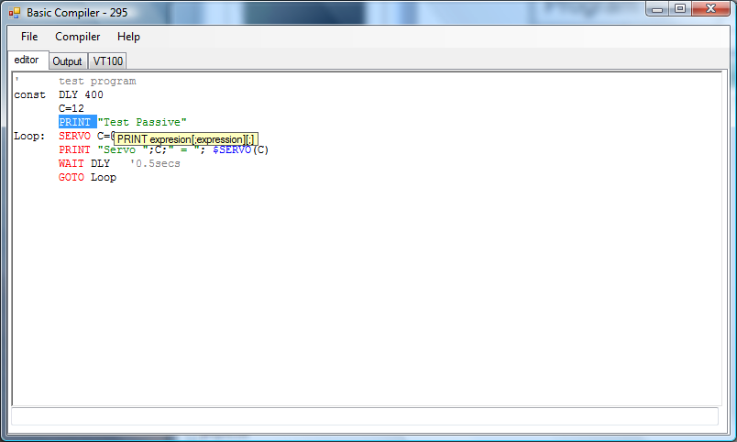
BASIC program editor
Version
number
Comments
Constants
Auto LET
Context sensitive help
Labels

Slide 2
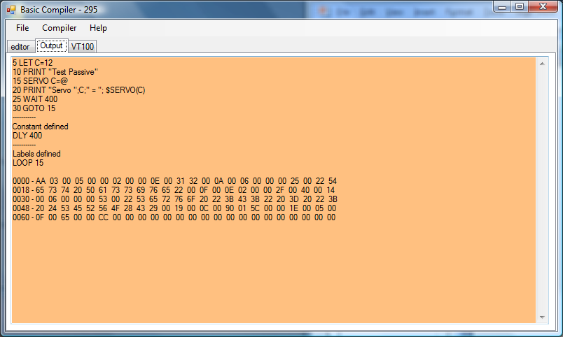
Output window
First pass output
Constants
Labels and line numbers
Compiler output (ready for download)

Slide 3
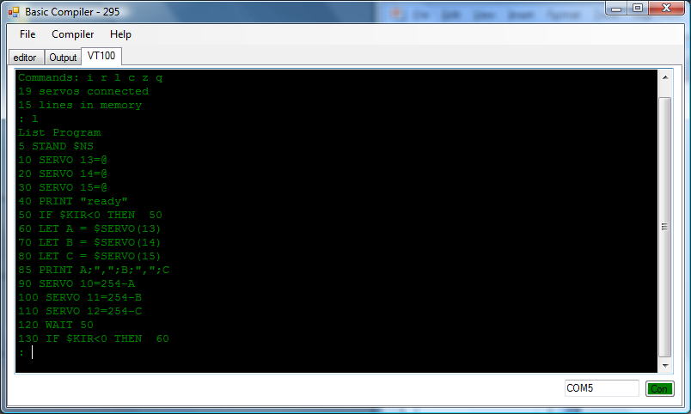
Terminal to connect to Robobuilder
COM port to use
Connection status
(green / red)

Slide 4
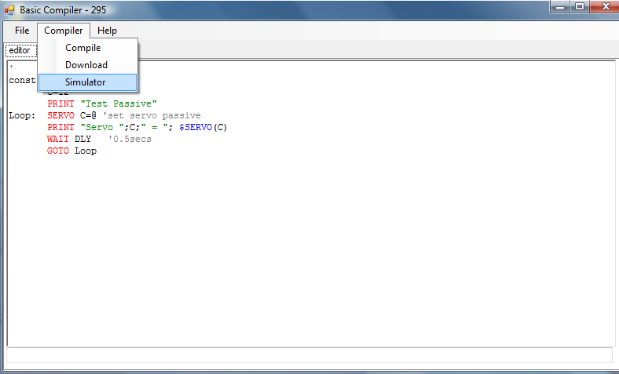
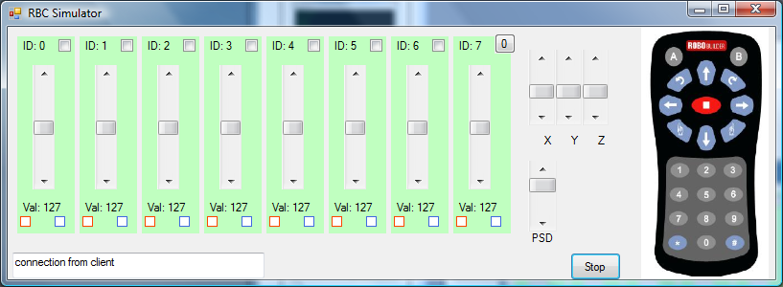
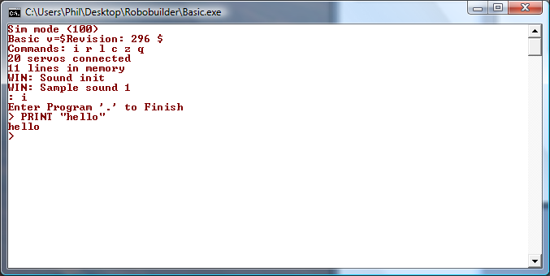
Simulator
Accelerometer
values
IR
Remote
Servo 0-23
Selector
Servo ID
Set
value
Read
value
IO port
PSD
value
Server
messages
Start / Stop
Basic.exe

